Slide 1

Design Document
Presentation
Domain Model & Lo-Fi Prototype

Slide 2
This Week’s Progress
Domain Model
NPC interaction mockup
Investigation mockup
Decision making mockup
Researched Unity assets
Created several candidates for story

Slide 3
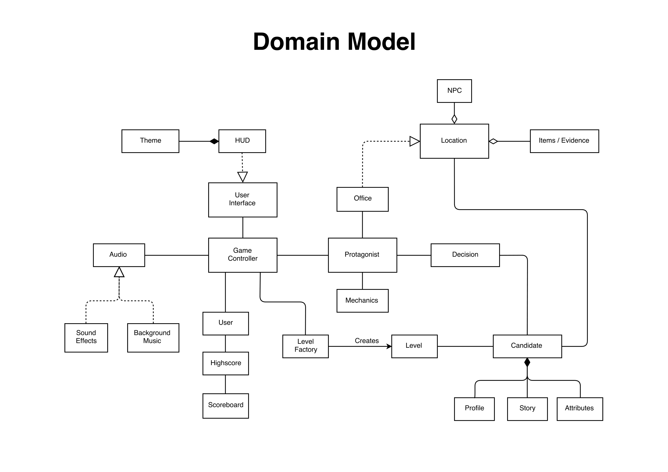

Slide 4
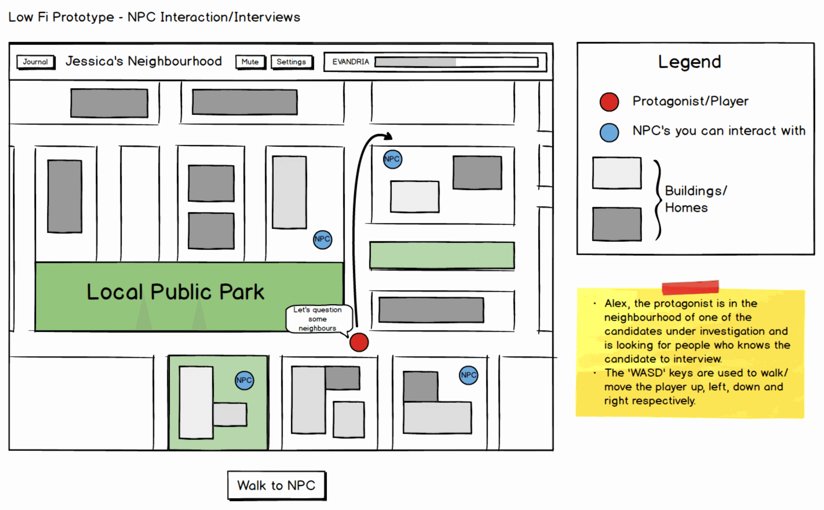

Slide 5
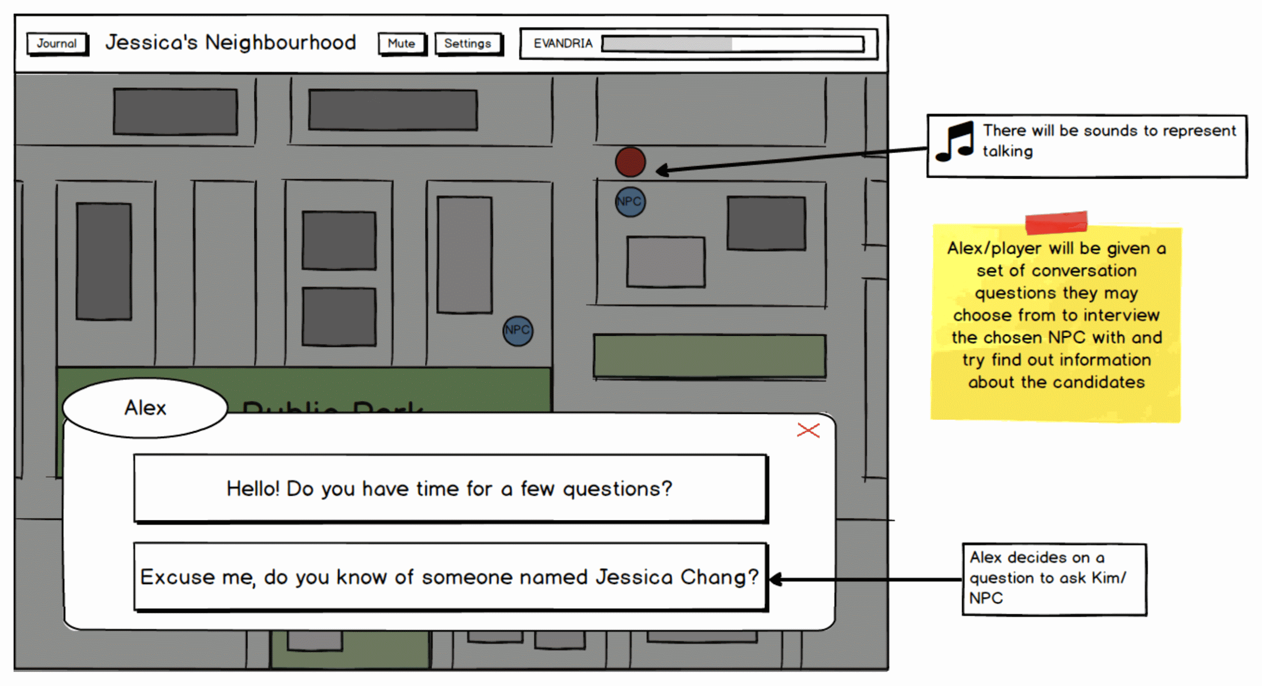

Slide 6
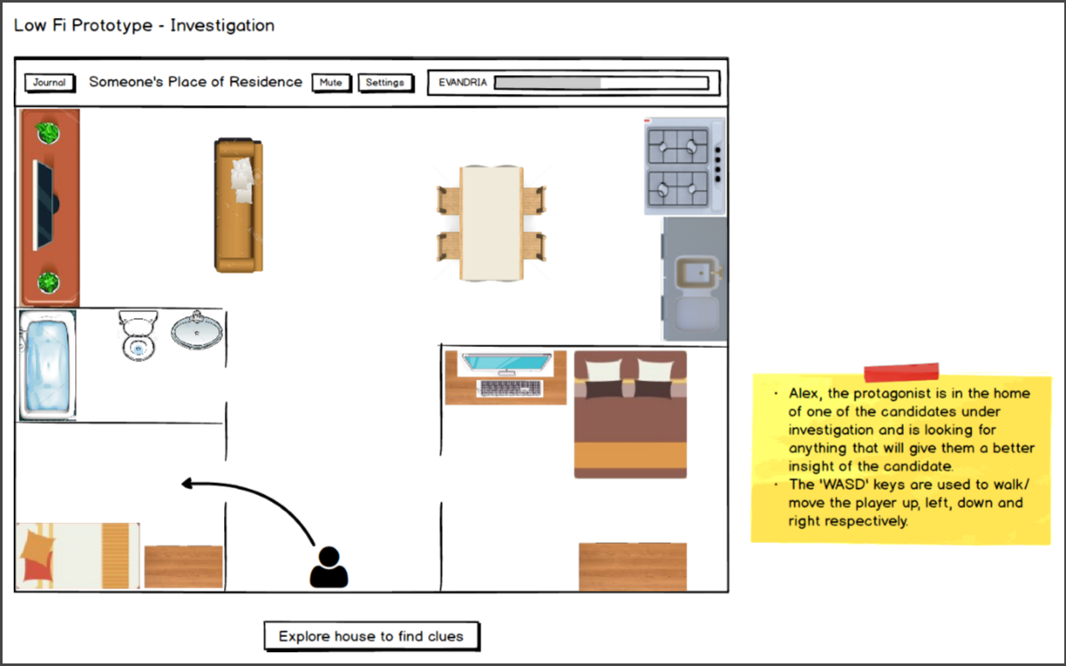

Slide 7
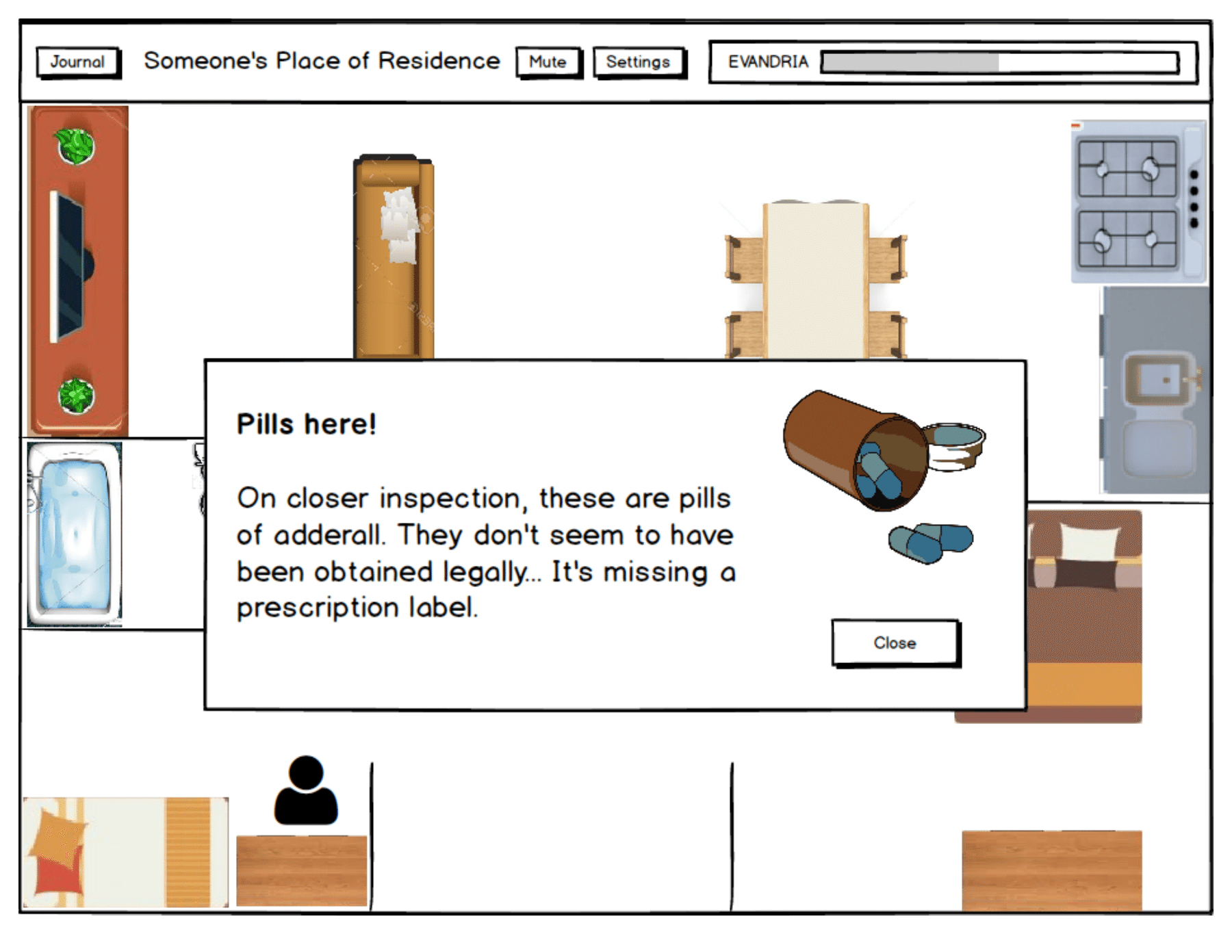

Slide 8
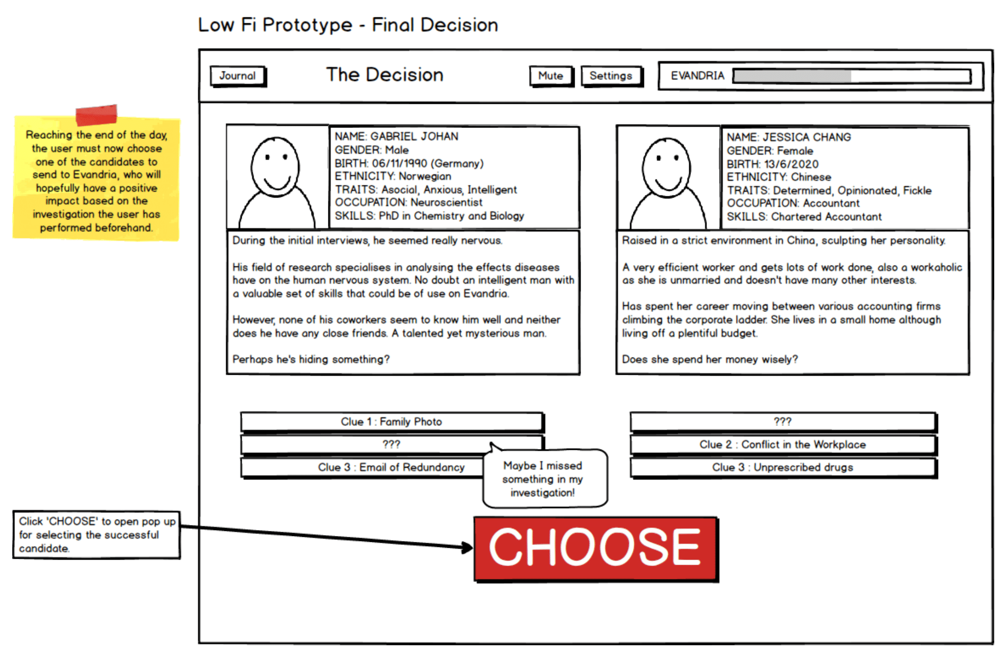

Slide 9
